Slide 1





Logo similarity
Author: Stanescu Miruna-Ioana
Date: 14.11.2025
GitHub: Miruna1208

Slide 2
Understanding the Problem
Goal: Match and group websites by the similarity of their logos.
Two possible approaches to tackle the problem:
1. Full Logo Comparison:
One approach is to compare all logos and group websites with visually similar ones. This helps detect duplicates across sites and identify potential copycat or fraudulent brands.
2. Unique Logo Focus:
Another approach is to keep only unique logos, identifying which websites have truly distinctive branding. This is useful for analyzing originality and uniqueness, showing which companies stand out visually.

Slide 3
First Approach
Logos were initially saved based on name similarity, using Levenshtein comparison to avoid duplicates.
For each brand, only a single representative logo was kept from the list of multiple websites with the same brand, allowing image-based comparisons to be performed efficiently without redundant data.
While this initial method helped reduce duplicates and organize the dataset for early testing, it was limited in scope.
This approach was eventually abandoned because it was inefficient and could not achieve the main goal without machine learning
It also became clear that after processing, the resulting dataset was very small due to the large number of duplicates in the initial set.
Therefore, the correct approach for this dataset is not clustering purely based on logo appearance, but rather grouping logos to identify potential fraud and repeated brand misuse across different websites.

Slide 4



Chosen Approach
Comparing all logos and grouping visually similar ones.
The task explicitly requires a solution without machine learning.
This constraint limits advanced image analysis, so the focus is not on fine-grained differentiation but on reliably extracting logos from the entire website list.
Scope: Detect fraudulent websites:
potential copycat

Slide 5
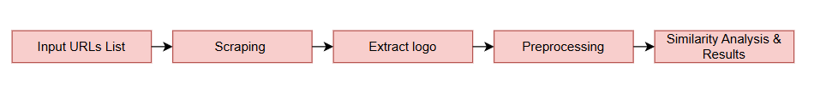
Technical Workflow
This system follows a structured processing pipeline that transforms raw website URLs into validated logo matches. The architecture combines scraping, preprocessing, and similarity scoring to ensure accurate and consistent results.

Slide 6
Web Scraping & Logo Extraction
This stage retrieves webpages, searches for logo-related assets, and stores successful results or errors in dedicated output files.
Data source: domain list loaded using PyArrow.
Fetching phase: HTML content retrieved via HTTP GET with User-Agent header.
Logo detection: favicons from <link> tags, <img> tags filtered by alt/class/id keywords, inline <svg> elements, <picture>/<source> tags, and CSS background-image styles are scanned sequentially according to a defined priority.
Output handling: successful detections appended to good_links.csv; missing or failed extractions recorded in bad_links.csv and persistent failures moved to error_links.csv.

Slide 7
Preprocessing & Analysis
Extracted images are standardized: SVGs rasterized to PNG, all images converted to RGBA, and saved in the logos/ folder.
Initial logo extraction achieved ~84% success. By refining heuristics to search for logo-related keywords in <img>, <div>, and other container elements, and improving favicon, SVG, and background handling, the success rate increased to over 97%, meeting the project requirement.
False positives (images that are not logos) are identified and manually removed to improve dataset quality, which was the most efficient approach for the task at that stage.

Slide 8
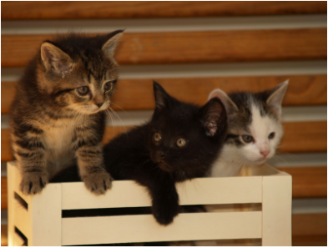
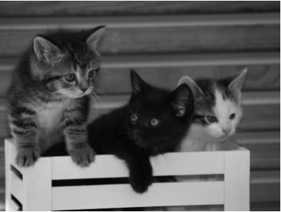
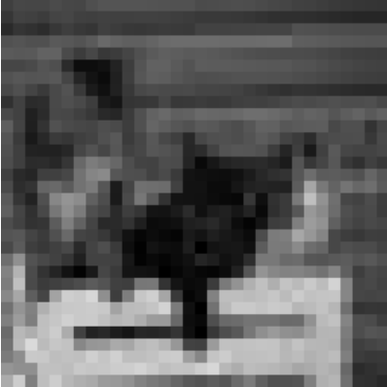


Similarity analysis
The similarity analysis uses perceptual hashes computed during preprocessing to compare logos.
How does pHashes work?
1010010010101101100110011011001101100010100100000111011010101110
The pHash algorithm converts the image to grayscale, scales it down (e.g., 32×32), and applies a discrete cosine transform (DCT). High-frequency components are cropped to the top-left 8×8 block, the median gray value is calculated, and a binary hash is generated to represent the image’s visual features.
Source: https://apiumhub.com/tech-blog-barcelona/introduction-perceptual-hashes-measuring-similarity/

Slide 9
Similarity analysis
Each logo image is compared against all others, and those with a hash difference below a defined threshold (18) are grouped together.
Groups of visually similar logos are saved in grouped_links.csv, with each group containing URLs of logos considered similar.
Logos that do not match any other are treated as unique and stored separately in Unique_Groups.
For each group, the corresponding image files are copied from the logos folder into dedicated group folders in grouped_logos, facilitating visual inspection.
517 groups of visually similar logos were identified, of which 183 were unique.

Slide 10

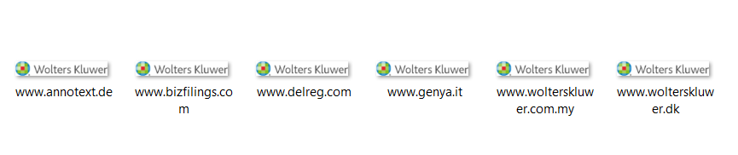
Results & Conclusions
After careful analysis, several logos with the same visual symbol but different names were identified, providing useful insights for potential fraud detection or brand misuse.
The workflow successfully extracted and grouped logos, meeting the requirement of over 97% coverage. Using automated extraction, preprocessing, and perceptual hashing, visually similar logos were efficiently clustered without ML algorithms. Unique logos and logos with identical symbols but different names were identified, providing insights for potential brand inconsistencies or anomalies.
Future improvements could include handling error links such as 403 responses using retries, proxies, or session management, applying machine learning to ensure that extracted images are actual logos, exploring advanced similarity metrics for more accurate clustering, and automating parts of the manual review process to reduce false positives and improve efficiency.

Slide 11
References
Image hashing & pHash algorithm - Zauner, Christoph. Implementation and Benchmarking of Perceptual Image Hash Functions. 2010.
BeautifulSoup – Web scraping library - https://www.geeksforgeeks.org/python/beautifulsoup-scraping-link-from-html/
Logo Extraction - https://www.brand.dev/blog/a-developers-guide-to-scraping-logos-from-websites
SVG to PNG - https://blog.devgenius.io/svg-to-png-from-vector-to-pixel-perfect-f4d496b9ad6d
Certain clarifications and text formulations were supported using AI-assisted tools (ChatGPT)

